Slide 1
EXPLORATORY DATA ANALYSIS
FACTORS AFFECTING THE ATTRITION
By:
Manikandan Raja :D22029
Benwin Anthony :D22032
Kenwin Dass C :D22051

Slide 2
INTRODUCTION TO DATASET
We are exploring the data of the company and the factors that are causing employee attrition.
Employee attrition dataset has 20 variables describing 1470 employees. Out of those 20 variables we found some variables which are important as per our point of view.
Employee attrition rate in this company is found to be 16%.
With all information we have, we are analyzing the variables that causing the attrition of the employees.

Slide 3
TYPES OF FEATURES IN THE DATASET
Continous Features
Categorical Features
Business Travel
Department
Education Field
Environment Satisfaction
Gender
Job Involvement
Job Level
Job Satisfaction
Marital Status
Overtime
Work Life Balance
Numerical Features
Age
Monthly Income
Total Working Years
Years At Company
Years In Current Role
Years Since Last Promotion
Years with Current Manager
Distance From Home

Slide 4
UNIVARIATE ANALYSIS
In this company, We have found that
Under our analysis , in this company out of all employees,150 employees are non-travellers and nearly 277 employees are travelling very frequently and 1043 employees are travelling rarely who are either working or left the company.
Under our analysis, in this company out of all employees 588 employees are male and 882 employees are female who are either working or left the company.
Under our analysis , in this company out of all employees 470 are singles, 673 are married and 327 are divorced who are either working or left the company.
Under our analysis, in this company out of all employees majority of the employees are getting paid by the salary which is less than 3500.
Under our analysis, in this company out of all employees 416 employees have worked over time and 1053 employees are working in general timing
Under our analysis, in this company out of all employees majority of the employees has given rating 3 for their work life balance

Slide 5
BIVARIATE ANALYSIS
Major Factors Affecting the Attrition :
Business Travel
Marital status
Job level
Environment satisfaction
Job involvement
Job satisfaction
Over Time
Work life balance
Monthly income

Slide 6
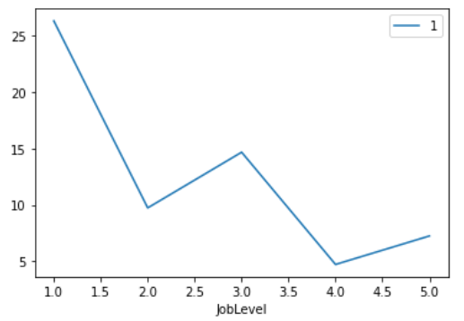
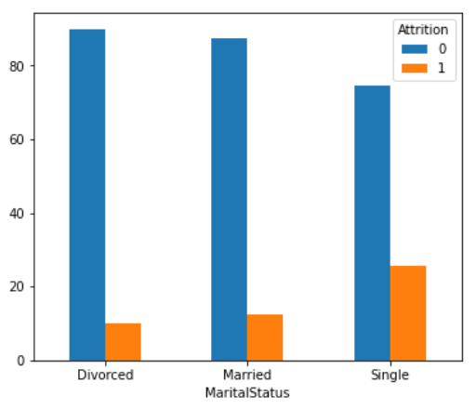
Job level vs Attrition:
Marital status vs Attrition:
Interpretation:
Under our analysis , in this company, employees who are singles having higher possibility to leave the company, comparing divorced and married .
Inference :
This may be due to lack of commitments and responsibilities.
Interpretation :
Under our analysis employees who are under the job level 1 are more likely to leave the company,
Inference :
this may be due to less responsibility , less experienced employees

Slide 7
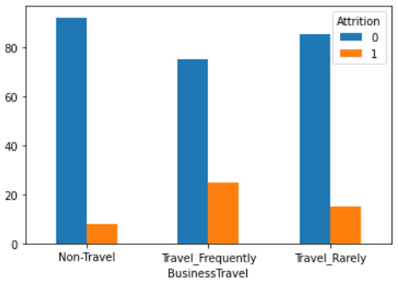
Business Travel vs Attrition
Interpretation:
As per the observation in this company
attrition rate is high for the employees who travel frequently .
Inference:
we might conclude that reason for the attrition might be due to exposures gained by the employee who travel frequently .
On other perspective ,the employees leave the company due to long travel and facing health problems , imbalance social life.

Slide 8
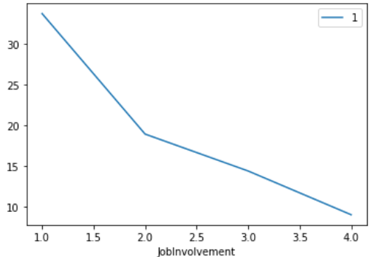
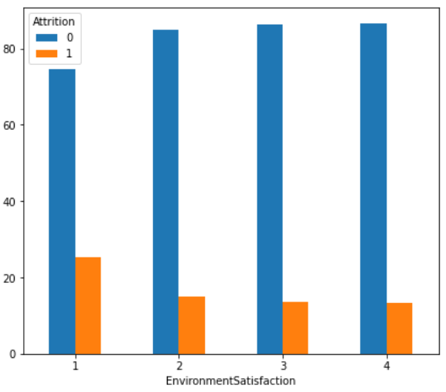
Job Involvement vs Attrition :
Environment Satisfaction vs Attrition:
Interpretation:
In this company the employees with job involvement category 1 has higher possibility to leave the company, attrition rate is negatively associated with the Job involvement
Inference :
This may be due to the domain given to the employee is irrespective to his education
Interpretation:
It is observable that In this company employees with environment satisfaction category 1 are more likely to leave the company ,attrition rate is negatively associated with the environment satisfaction .
Inference :
This might be due to Poor ecosystem , Negative Hospitality.

Slide 9
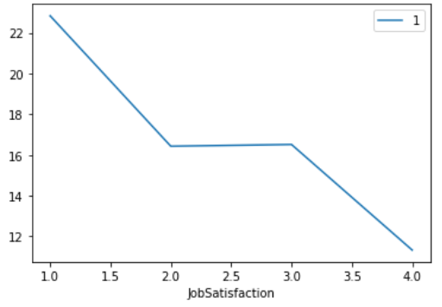
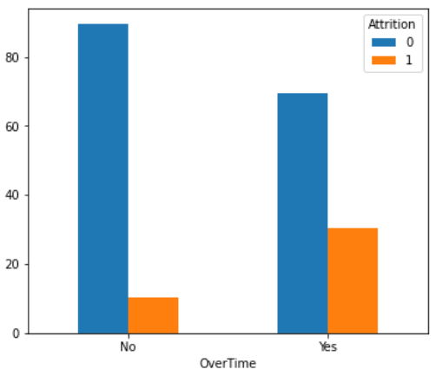
Job Satisfaction vs Attrition :
Over Time vs Attrition :
Interpretation :
Under our analysis in this company the employees with job satisfaction category 1 has higher possibility to leave the company
Inference:
This may be due to Responsibility mismatch, less growth opportunity, lack of appreciation.
Interpretation:
Under our analysis in this company the employees who has worked overtime are more likely to leave
Inference:
this may be due to company work life imbalance , less compensation , poor corporate culture.

Slide 10
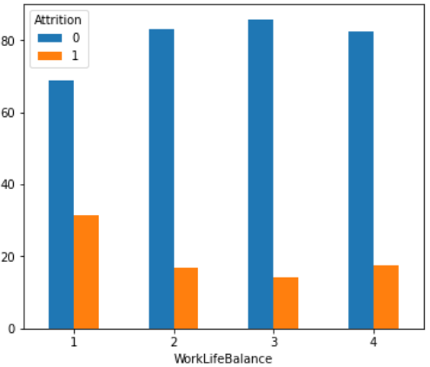
Work Life Balance v Attrition:
Interpretation :
As per the observation in this company
attrition rate is high for the employees whose work life balance is 1 are more likely to leave company
Inference:
We might conclude that the employees may prefer
Companies with Better work life culture

Slide 11
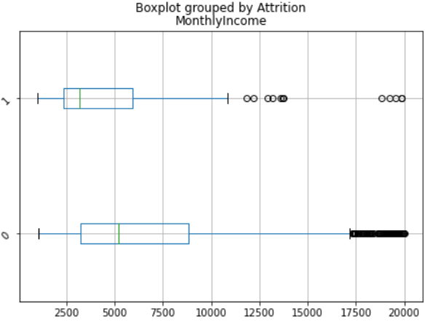
Monthly Income vs attrition :
Age vs attrition :
Higher attrition rate is strongly associated with a lower age group employees
In this company the average income for employees who left the company is lower than the one who stayed. This concludes that people with less monthly income are more likely to leave the company.

Slide 12
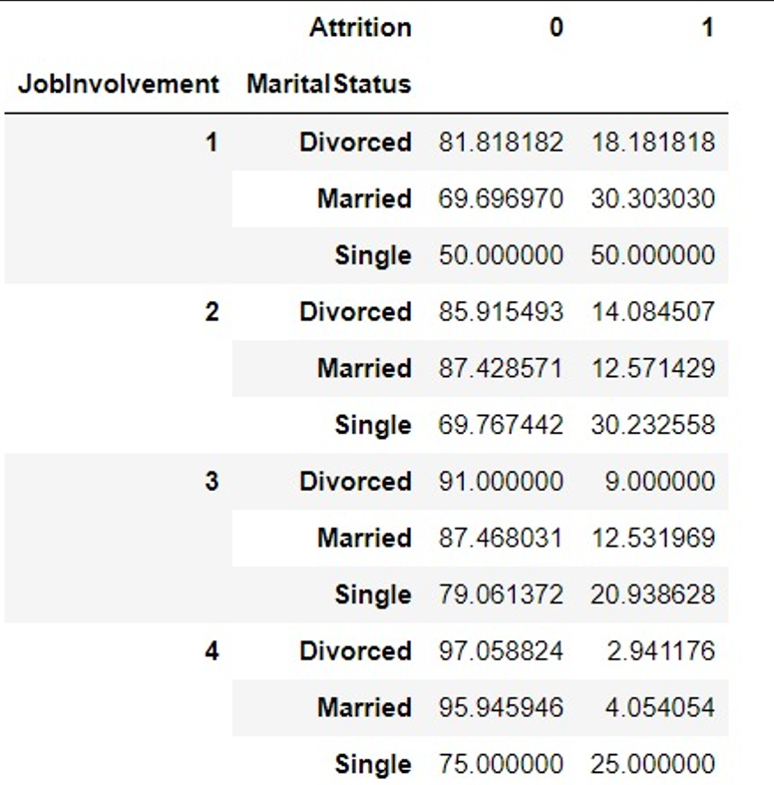
MULTIVARIATE ANALYSIS
Job involvement vs marital status vs Attrition :
Interpretation :
Under our analysis in every attribute of marital status, attrition rate for singles is higher while comparing to the divorced and married employees regardless of job involvement .
Attrition rate for singles is negatively corelated with job involvement

Slide 13
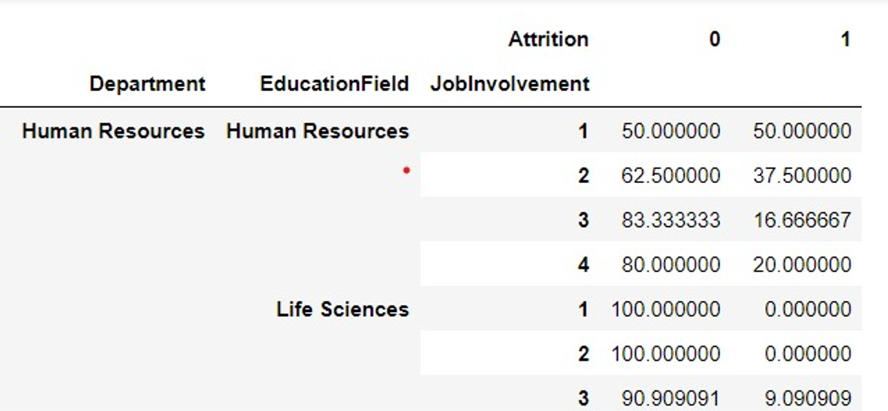
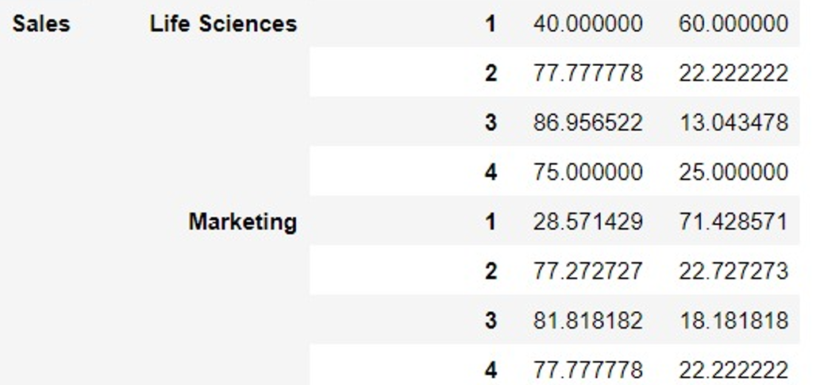
Department vs Education Field vs Job involvement vs Attrition :
Considering human resources department here
attrition rate is only 20% for employee who are working in the same domain with higher level of job involvement.
Interpretation :
hence , we can conclude that attrition rate is negatively associated with job involvement given for employee from same domain ,but job involvement 3 shows anomaly here.
From this we can conclude that employees who are working in different domain with lack of job involvement causes higher attrition here

Slide 14
LINK FOR ipynb file:
https://colab.research.google.com/drive/1zKo-RmhofNWv_hanoTIHs9bXKE1Mm4Q2?usp=sharing

